Slide 1
Learning Disability and Neurodiversity
March 2022

Slide 2
LD&ND System
Key indictors; Annual Health Checks (AHCs), Number of people in hospital and LeDeR | Design Group and Delivery Group; Formalised LPT led ICS Collaborative 1st July
All age; includes the ND Programme for Children and Young People | 28 projects in 2021/22; 15 more in 2022/23
Health Inequalities focused; champions and public health – AHCs, LeDeR (learning into action), population health data and health needs assessment | Close co-ordination with CAMHS; Mental Health Investment to maximise impact for community support prior to decisions to admit
Inpatient quality of care agenda; safe and wellbeing reviews and out of area placement | System wide commissioning of community placements

Slide 3
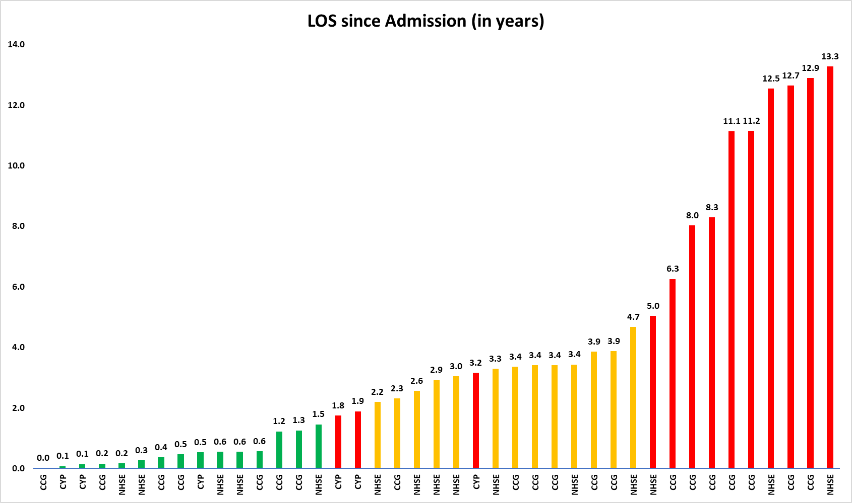
ID/Ref | Patient Category | Number of years as inpatient | Inpatient Legal Framework | Discharge planning status
13A.702A | NHSE | 5 | Section 47/49 | Not ready for discharge - MM Judgement
Q59.163 | CCG | 6 | section 37/41 | Ready for Discharge – Person and service spec in progress - MM Judgement
Q59.406 | CCG | 7 | section 3 | Ready for Discharge, Transition commenced - Discharge in April
Q59.326 | CCG | 8 | Section 47/49 | Ready for Discharge - MM Judgement
Q59.473 | CCG | 10 | Section 3 | Ready for Discharge - Looking for a provider
Q59.039 | CCG | 10 | section 37/41 | Ready for Discharge, in transition - MM Judgement
Q59.338 | CCG | 12 | Section 47/49 | Ready for Discharge - MM Judgement
13A.585 | IMPACT | 12 | Section 3 | Ready for Discharge, was going to the Meadows
Q59.051 | CCG | 12 | section 37/41 | Not ready for discharge - MM Judgement
13A.722 | IMPACT | 12 | Section 3 | Ready for Discharge, was having transition - Was going to the Meadows

Slide 4
LD&ND System Challenges in 2022/23
Challenges
Escalating complexity of caseload
Availability of specialist beds
Shortage of high quality community placements
Workforce supply and skills development
Approach
Formalised ICS Collaborative for more joint solutions to workforce and integrated care
Clinical pathways - competency frameworks - targeted training to meet needs of complex individuals
Investment into LLR for new service offers; CAMHS, LD and ASD
System wide solutions e.g, sensory environments, PBS training
Sustainably financed Agnes Unit providing rehabilitation and high dependency care locally
Health inequalities, LeDeR and the safe and wellbeing reviews based improvement focus
Intensive development of the community provider pipeline and simplification of procurement processes

Slide 5
LPT Services
Going well
Agnes Unit; QI, CQC, plans, culture | Access Pathway
LD&A Collaborative | LeDeR QI approach and autism readiness
QI Programme; administration, clinical pathways and job planning | Research bid - £2.8m
OD work with leaders; LLR Academy | Active staff H&WB agenda
Challenges
Sickness absence 5.9% YTD | Deficit £445k YTD (Month 11) Rehab beds, business case and Pod closure
Community acuity increase (future impact related to MHA reforms) | Waits for treatment (Adult Autism Diagnosis)
Impact of SystmOne on planning for waiting list reduction | Agnes Unit Demand and Complexity

Slide 6
Improvement Plans 2021/22 - Service and System
Access Work: Access team established Improved caseload, pathway and discharge supervision Job planning, scheduling & trajectories Use of H2 monies and bids against the £3.1m Clinic based service offer Equality impact and local access | LD&A System: Annual Health Checks – 68% (22nd March) LeDeR preparing for ASD 34 adult inpatient and 6 young people Safe and wellbeing reviews and panels completed Three year plan delivering Leading ICS Collaborative preparation Sensory environments Adult ED ASD response Year 2 investment plans awaiting NHSEI £ Strengthened SEND partnership
Workforce: Associate Psychologists - summer intake R&R premia – AU, Psychology, + Administration and SystmOne reform Clinical Educational Lead Community Matron recruitment AHP Operational – Professional Leadership roles Nurse Associate recruitment H&WB work | Agnes Unit Commissioning: CCG - all pods, ATU, HD & Rehab Business Case Regional rehab framework submission 28th Feb MM judgement proposal with CCG colleagues New build early engagement End report for LD QIP 2021/22 – Received Year 3 QIP governed by the collaborative

Slide 7
2022/23 Plans…
LD QIP and benchmarking outcomes have set improvement priorities for 2022/23 | Agnes Unit new/rehab offer
Increasing focus on autism | Formalisation and leadership of the ICS Collaborative
New services and investment - implementation | Improved access to community care
Step change in service user and staff experience | Comprehensive health inequalities workplan

Slide 8
Help…
Release of all the community budget to the community service to address: Clinical risks caused by increasing waits Increase in acuity Staff health and wellbeing | Continued support in Bradgate Unit building plans for the 12 bedded LD&A facility
Agnes Unit business case agreement with CCG system colleagues, and/or closure of Pods and mitigation to ensure we minimise the impact on OOA placements and we don’t re-open out of hours | Trust priority for 2022/23… Adaptation of all services to meet the needs of autistic people and people with a learning disability: Routinely regard this cohort as High Priority on all waiting lists A trustwide plan for sensory environments Accessibility benchmarking and improvement plans

