Slide 1
Introduction to the Dynamic Support Pathway (DSP)

Slide 2
Contents
What is the DSP?
Aims
Long Term Benefits
Co-Production
Referral Criteria
Referral Process
Multi-Agency Meeting Process
Multi Agency Meeting Notes Template
Key Lines of Enquiry
Action Plan
Next Steps

Slide 3
What is the DSP
The Dynamic Support Pathway (DSP) is a pathway developed to provide support for individuals (all age) with a Learning Disability, Autism or both who are deteriorating in their health and well-being whilst living in the community.
The goal is to identify concerns early and to be able to take steps to provide additional support in order to prevent further deterioration and any escalation, which may lead to a crisis.
The DSP is also for patients stepping down into the community from an in-patient unit. The Multi-Agency Meeting (MAM) can be used for post discharge follow up to monitor the delivery and suitability of the Discharge Plan.
This is not a replacement pathway for your other referrals to other services e.g. Early Help, Specialist Autism team (SAT), Safeguarding, LD Access etc. Please continue to make these referrals.

Slide 4
Aims
A more robust early intervention process
System wide community services that use a consistent processes to deliver crisis avoidance and crisis management activities
An effective DSP that will reduce the need for Care Education and Treatment Reviews (CETRs) and escalation to the Risk of Admission Register (ROAR)
Early identification of concerns in health and wellbeing so you have a chance of avoiding further deterioration which will lead to crisis.
Facilitated collaborative joint working
Bespoke action plans that will meet the individuals needs in the community
All stakeholders equally committed to deliver rapid responses
Processes that are responsive and able to be deployed quickly
The DSP will work alongside the CYP key Worker scheme in ensuring on-going health and wellbeing of children and young people (CYP)

Slide 5
Dynamic Support Pathway
Inpatient Discharge Dynamic Support Register (DSR)
At Risk of Admission Register (ROAR)
Dynamic Support Register (DSR)
Living well in the community
Post discharge Multiagency Meeting [2 weeks discharge]
Care (education) and Treatment Review
Multiagency Meeting

Slide 6
Long Term Benefits
Leicester, Leicestershire and Rutland (LLR) will have in place an inclusive, person-centred, proactive and preventative approach that supports the individual’s needs and preferences
When support is required all individuals will have access to the right support at the right time, in the right place and will be delivered by the right person
Adults, children and young people with a Learning Disability, Autism or both are able to thrive in the community in their own homes in the least restrictive environment possible, develop independence, make their own choices, be able to integrate into society, maintain family and friend relationships, take part in hobbies and activities and lead a life of 'beautiful ordinariness'
Families remain together
Inappropriate admission and re-admission prevention
If admission is required appropriate beds are available close to home and family

Slide 7
Co-production
“It’s great for parents’ voices to be heard in developing referral forms. Previously we have never been able to see these, but they have affected us. Parents are left to carry the load of the process”
“We are enjoying the conversations we are having across the board. As parents we love coming on board with your projects so parents’ voices come through…”

Slide 8
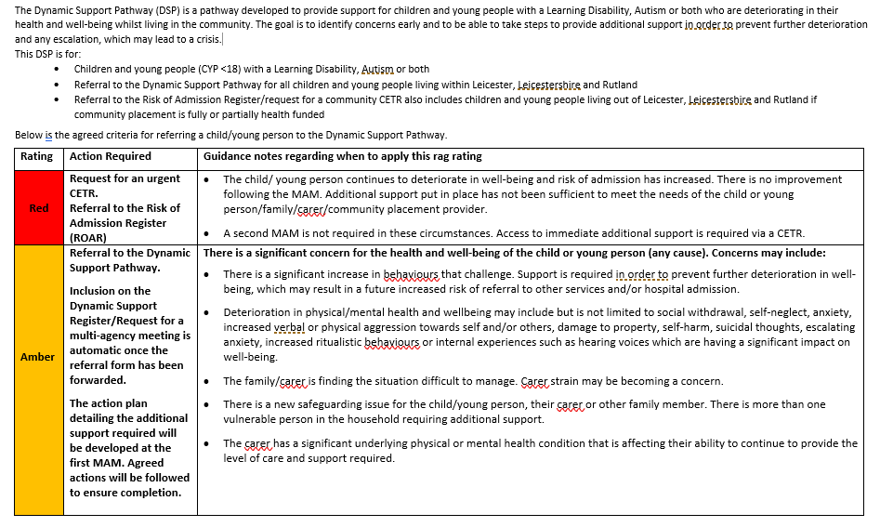
Referral Criteria - CYP

Slide 9
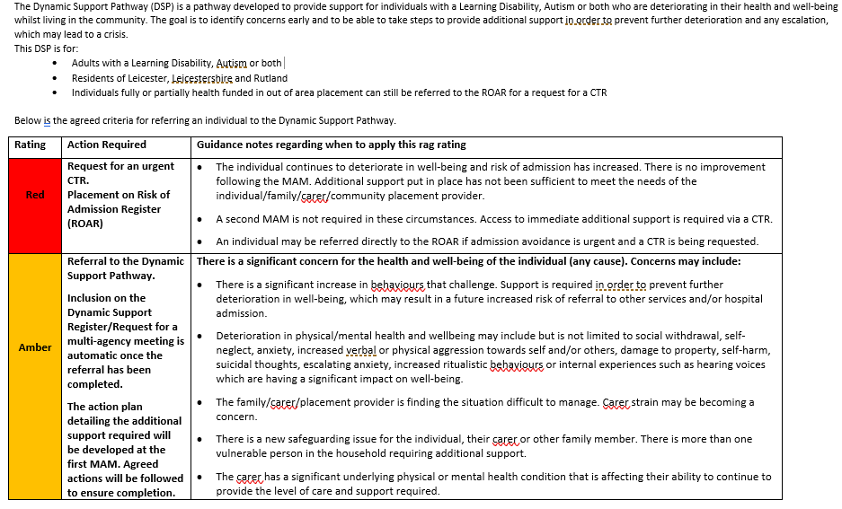
Referral Criteria - Adult

Slide 10
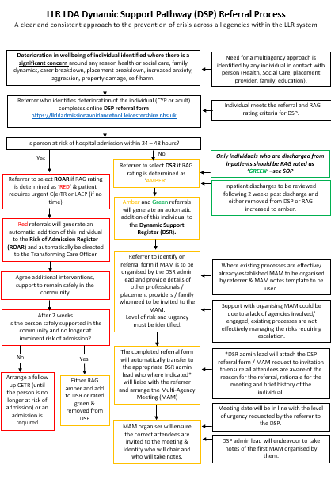
Referral Process

Slide 11
The Referral Process
Referral form accessed via online platform: https://llrldadmissionavoidancetool.leicestershire.nhs.uk
Accessible to Health, Social Care and Education teams
Consent is required. Consent form is available on the DSP website page https://www.leicspart.nhs.uk/services/dynamic-support-pathway/
Multi-Agency Meeting (MAM) notes template available on the DSP website page
Standard Operating Procedure (SOP) available on the DSP website page
Gaps in Service Form available on the DSP website page to support with identifying and addressing gaps in services

Slide 12
Contents of the Referral Form
Patient ID information
Demographic information
Commissioner information
Patient/carer information
Current care team
Current location/home/provider
Communication needs
Brief History
Overview of the Current Situation/Current Concerns
Risk Details
Safeguarding Information
Additional support already in place?

Slide 13
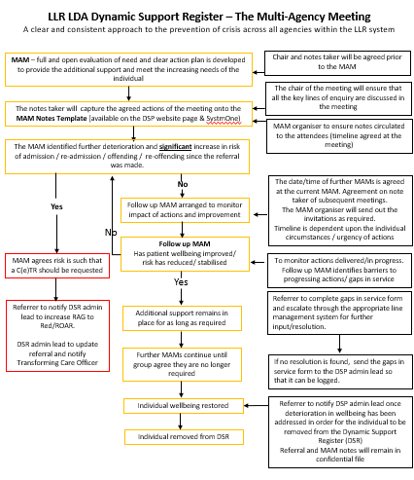
Multi-Agency Meeting (MAM)

Slide 14
The MAM Notes Template
All sections of this template should be discussed at the Multi-Agency Meeting (MAM)
Simply here to provide guidance and information as to what will be asked and discussed during the meeting
Addresses the Key Lines of Enquiry
This template can also be used as an update template for subsequent multi-agency meetings. In this instance any changes in circumstances or presentation can be recorded and a new action plan developed.
Captures the names and contact details of all attendees
Captures the action plan, key tasks, who will complete them and timelines required
Key questions regarding what happens next

Slide 15
Key Lines of Enquiry
Update on Current Situation (since referral or last MAM)
Physical Health
Appropriate Care and Support
Parent, Family and Carer involvement
Aspirations of the Individual
Rights and Legal Frameworks
Education (if applicable)
Impact of Covid-19
Safe
Least Restrictive Environment
In-Patient Treatment Recommendations (If applicable)

Slide 16
Action Plan
Action Plan
Action | Responsibility | Timeline Required | Outcome
Aspirations of the Individual
Can the aspirations of the individual/family/carer be met by this action plan? If not, please provide a short rationale as to why this is not possible.

Slide 17
Key Questions
Next Steps
Is a follow-up MAM required? | Yes/No
Agreed date of next MAM
Can the individual be removed from the Dynamic Support Register? | Yes/No
Is escalation to the ROAR required for a C(E)TR? | Yes/No
Questions for the Next MAM
Have the actions from the first MAM been completed?
Have the actions from the first MAM been successful in addressing the concerns identified?
Have the aspirations of the individual and family been achieved?
What additional support can be put in place to further support the individual, family/carer?
What needs to remain or be put in place to ensure this deterioration in health and well-being/increase in risk does not happen again?

Slide 18
Further information
Link to online platform to refer: https://llrldadmissionavoidancetool.leicestershire.nhs.uk
Link to DSP website page: https://www.leicspart.nhs.uk/services/dynamic-support-pathway/
Children and Young People (CYP) Dynamic Support Register (DSR) email address: lpt.childrens-lda.dsp@nhs.net
Adult Dynamic Support Register (DSR) email address: lpt.adult-lda-dsp@nhs.net
Risk of Admission Register (ROAR) email addresses: Laura.rodman@nhs.net or Matthew.childs2@nhs.net

