Slide 1
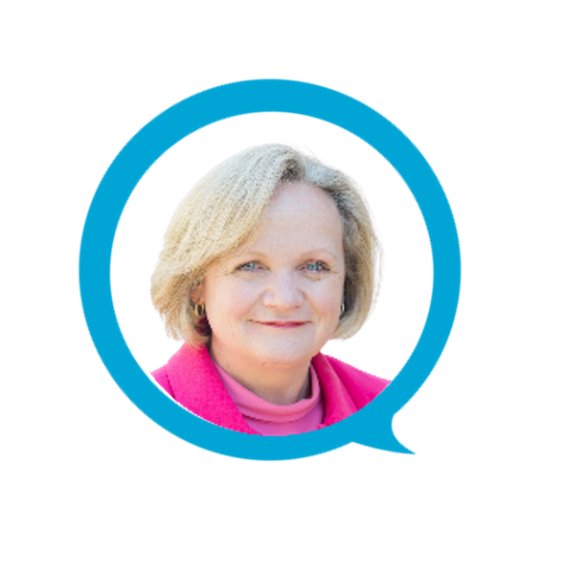
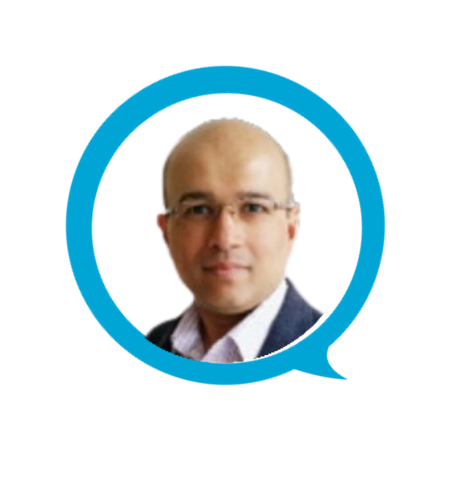
We are Together Against Racism LPT Trust Board Pledges
 | Crishni Waring, chair Racism is an injustice that causes real harm to our NHS people and the communities we serve. How do I show my commitment? Passionately advocating for racial justice and challenging behaviours that demonstrate a lack of compassion and inclusion
 | Angela Hillery, chief executive People matter and I know we need to take steps to create a culture of inclusion and belonging for all. How do I show my commitment? Leading, setting expectations and using my voice to challenge every day.
 | Jean Knight, managing director/ deputy chief executive: There is no place for racism in LPT and we should embrace diversity standing together in solidarity today and always. We must – and will – take action to address the problems that exist, and I pledge to listen and act on concerns shared with me. How do I show my commitment? I will continue to strive to create an inclusive culture of learning and change.
 | Faisal Hussain, deputy chair and non-executive director and deputy chair I believe in social justice and a society which is rooted in fairness and equity irrespective of the colour of a person’s skin. How do I show my commitment? Ensuring that I help create an environment which recognises and values diversity and enables an inclusive culture where we have a workforce that reflects the communities we belong to and serve.
 | Josie Spencer, non-executive director I am committed to understanding and addressing the challenges faced by those who experience racial discrimination, be they patients, colleagues, or members of our communities. How do I show my commitment? I pledge to have zero tolerance against racism, and to always challenge racist speech and behaviours. To do this, I pledge to continue my journey as an Ally, building my knowledge, understanding and awareness of racism in our society .
 | Hetal Parmar, non-executive director People are at the heart of what we do and I believe in a culture where everyone can be themselves and can speak up when needed. How do I show my commitment? I will support this by respecting individuals, listening, challenging with empathy and helping to create an environment of inclusion.

Slide 2
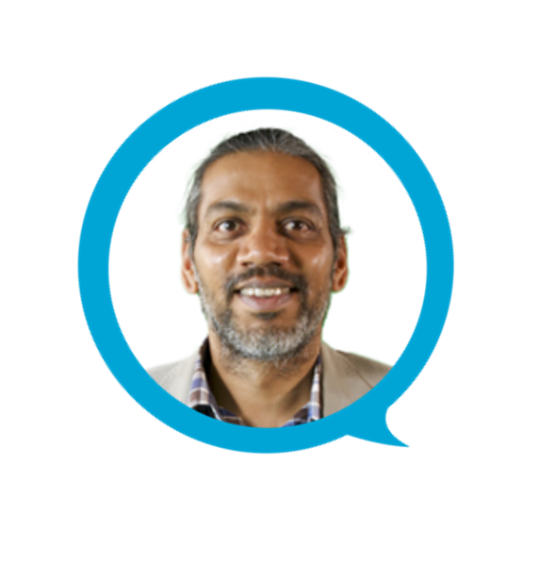
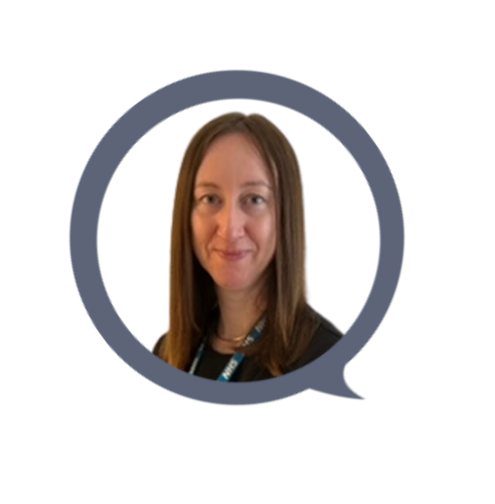
We are Together Against Racism LPT Trust Board Pledges
 | Manjit Darby, non-executive director I pledge to be a visible champion in my leadership role as non-executive director. How do I show my commitment? I will continue to support and mentor global majority staff and use my lived experience at Board level to make sure we actively address racism and discrimination at LPT.
 | Alexander Carpenter, non-executive director Having a diverse, equitable and inclusive workplace where everyone can bring the best of themselves to work every day is essential to helping achieve our purpose. I’m passionate about creating a culture where people are comfortable being their true selves. How do I show my commitment? I pledge to celebrate and respect everyone’s strengths and differences and share my knowledge and experiences, giving everyone the same opportunity to grow and express their opinions. I will actively challenge all forms of discrimination..
 | Sharon Murphy, executive director of finance I want everyone to thrive and feel that they work in a culture that supports them every day 100%, whoever they are and whatever their background. How do I show my commitment? Continuing to learn how to be anti-racist and ensuring that my behaviours always align with those values.
 | Bhanu Chadalavada, executive medical director I am committed to addressing health inequalities for our community and ensure that we have a diverse workforce with equal opportunities for career progression. How do I show my commitment? I will work towards ensuring proportionate access of healthcare and accessibility of high quality treatments to all population groups. I will encourage and support the development of inclusive leadership within healthcare.
 | James Mullins, interim executive director of nursing, AHPs and quality I’m committed to be together against racism because I believe that inclusion and diversity unleash innovation and create a culture where everyone feels that they have equal opportunity. How do I show my commitment? EDI is important to me because, in LPT, people are our most important asset, and I am committed to being actively and visibly supportive to staff as part of their own career development via mentoring/coaching.
 | Kate Dyer, director of governance and risk I contribute to and encourage a culture of inclusion and belonging for everyone. I do not tolerate racism or ableism. How do I show my commitment? I actively live this commitment in all areas of my life. I recognise, value and celebrate diversity and disability equality.

Slide 3
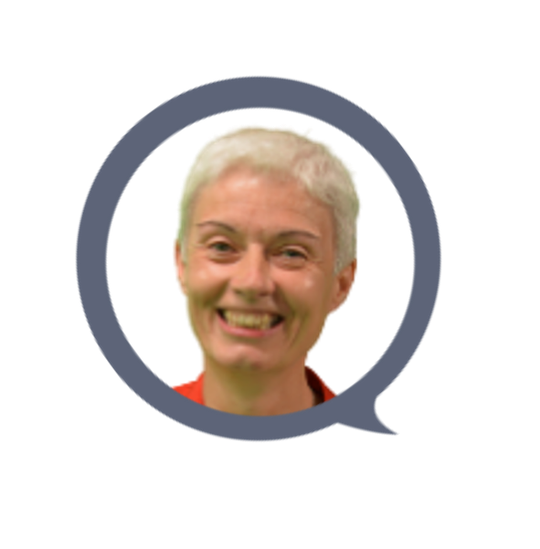
We are Together Against Racism LPT Trust Board Pledges
 | Sam Leak, executive director of community health services: It is important to take positive action to prevent racial discrimination of any kind. I shall educate myself and others in race and racism and stand up against racism; calling it out whenever and wherever I see it. How do I show my commitment? I will at all times respect individuals; as individuals and ensure that everyone has a voice and is listened to.
 | Tanya Hibbert, executive director of DMH To embed a culture within DMH where staff feel respected and valued and part of a team where they feel supported and able to fulfil their potential. How do I show my commitment? Being present for my DMH colleagues including co-chairing the DMH monthly EDI meeting, chairing the DMH Monthly Team Talk session, exec sponsor for the neurodiverse staff network in LPT, leading on the delivery of the new reasonable adjustment clinics, visiting DMH teams each week and more.
 | Paul Williams, interim executive director of FYPCLDA To be a positive example to others in the organisation by calling out racist language and behaviour when I see it. To encourage colleagues to speak out about racism to ensure that action is taken where examples of racism are identified within the Trust. How do I show my commitment? To continue my learning journey as an ally.
 | Sarah Willis, director of human resources and organisational development We need to eliminate injustice, particularly racial, for our staff and the communities we serve. How do I show my commitment? Listening and challenging behaviours I see with compassion and empathy, ensuring I look within to understand my experiences and potential privileges.
 | Paul Sheldon, chief finance officer I believe in a fully inclusive and diverse world where people have equal opportunities. How do I show my commitment? I will continue to educate myself and listen to the voices of people who experience racism as well as challenge racism and discrimination.
 | David Williams, executive director of strategy and partnerships Racism is wrong, it harms all of us. How do I show my commitment? Championing equality and speaking.

