Slide 1

“I was still trying to end my life.”
— Jason, six weeks before his first Flow session
This is the story of what changed — and the evidence behind it.
Flow tDCS in Crisis Care
Dr M. McConnochie
Consultant Psychiatrist, Clinical Director for Urgent Care, Leicestershire Partnership NHS Trust
Dr S. Abdalla
Consultant Psychiatrist, Lead Consultant for Crisis Team, Leicestershire Partnership NHS Trust
Notes:
Open with Jason's line only - don't explain who he is yet, just let it sit for a beat. Then say the pivot line aloud. Only then introduce yourselves and the programme. This is the hook - don't rush it.

Slide 2
AMBITION — THE SCALE OF THE PROBLEM
Depression is one of the UK's biggest health challenges — and it's growing
1 in 6
5.4m+
280m+
adults in Great Britain report moderate-to-severe depressive symptoms
people in England recorded with depression on GP registers
people affected by depression worldwide
Sources: ONS, Cost of living and depression in adults, Great Britain (2022); NICE guideline NG222; World Health Organization
2
Notes:
Set out the scale of the problem with the national statistics, then use the patient quote to make it real - not just a number. This establishes why this matters before you explain what you built.

Slide 3
AMBITION — WHEN STANDARD TREATMENTS AREN'T ENOUGH
Medication and ECT don't work, or aren't right, for everyone
Medication
ECT
Up to 1 in 3 people with depression don't respond adequately to antidepressants, even after multiple attempts — known as treatment-resistant depression.
Electroconvulsive therapy can be highly effective, but requires anaesthesia and hospital attendance, and carries a risk of memory-related side effects — it isn't accessible or acceptable for every patient.
Sources: Fabbri et al., King's College London (2021); NICE guideline NG222; Royal College of Psychiatrists
“Patients thought they had no other options, and we used the Flow device, and it was a complete 180 change.”
3
Notes:
This slide names the gap directly: medication and ECT are valuable but don't work, or aren't right, for everyone. Use the patient quote to ground this in lived experience before moving to your solution.

Slide 4

THE IDEA
A 30-minute headset, worn at home, is changing what recovery from a mental health crisis looks like
By the time patients reach LPT's Crisis Resolution and Home Treatment Team, many have already tried antidepressants and talking therapies — without success.
Without a further option, the pathway is hospital admission.
We set out to build that further option.
Aligned to national priorities
Expand community-based care
Reduce avoidable hospital admissions
Improve access to evidence-based innovation
Strengthen suicide prevention
4
Notes:
State the throughline sentence exactly as written on the slide - this is the one idea you want the panel to still remember after nine other pitches. Then give the context briefly and name the national priorities.

Slide 5
WHAT WE BUILT
A clinically-supported, scalable treatment — delivered at home
First UK NHS Crisis Team to deliver home-based tDCS for depression
1
2
3
4
What it is
How it works
How it's used
How it's governed
A CE-marked, Class IIa medical device (Flow Neuroscience headset) delivering transcranial direct current stimulation.
A small 2mA current — about the same as a Christmas tree lightbulb — increases activity in the frontal brain, easing depressive symptoms.
Worn for 30 minutes, several times a week, self-administered by the patient in their own home.
Defined inclusion/exclusion criteria, informed consent, weekly clinician review for safety, adherence and effectiveness.
5
Notes:
Explain simply what Flow is and how it works - CE marked Class IIa device, low current, self-administered at home under clinical oversight. Emphasise this is the first UK NHS Crisis Team to do this.

Slide 6
COLLABORATION
Built with clinicians, patients and system partners — not delivered to them
Crisis Resolution & Home Treatment Team
All the team was actively involved — practitioners, pharmacists, psychologists, consultants and resident doctors — identified patients, onboarded and reviewed them weekly.
Patients
Contributed structured feedback and symptom reports that shaped usability, adherence and support needs — not just recipients of care.
Provided initial pilot funding, clinical/technical expertise and top-up training; joint ownership of the evolving evidence base.
Flow Neuroscience
King's College London
Academic research partner — links clinical delivery to independent, peer-reviewed evaluation of outcomes.
Health Innovation East Midlands
Co-hosted a multistakeholder workshop with CRT and Flow to gather staff feedback and map the pathway.
Raising Health (LPT charity)
Secured £40,000 to scale the programme into community mental health and eating disorder services.
“Flow has allowed our crisis service to rapidly treat high-risk patients with depression in the most effective way we can, be more patient-centred, and reduce admissions.”
— Dr Mark McConnochie, Consultant Psychiatrist, LPT
6
Notes:
Stress that this was co-designed, not imposed: the whole team across multiple disciplines, patients feeding back throughout, Flow Neuroscience, King's College London, HIEM and Raising Health as partners. Use the McConnochie quote to bring it to life.

Slide 7
IN STAFF'S OWN WORDS
The people delivering this see it too
“
“
If it does make a difference to me, it's bound to make a difference to someone else.
Given the amount of money, the device and the other big costs, for me, it was really cost effective for what it did.
— Molly , LPT CRT Staff (used Flow herself)
— Matt, Nursing Staff, LPT CRT
7
Notes:
This is a bridge slide before the data - staff seeing the same impact patients describe. Molly's two quotes work well read back to back; pause briefly between them.

Slide 8
IMPACT — THE PILOT (N=80, 6 WEEKS)
Rapid, statistically significant improvement in a high-risk population
71%
↓ 2/3
~80%
30%
reliable reduction in depressive symptoms at 6 weeks (p<0.001)
reduction in suicidal ideation by 10 weeks (↓1/3 at 3 weeks)
of patients reported improvement
achieved full remission
Delivered in a clinically severe, high-risk cohort: ~50% with a history of self-harm and ~20% with a personality disorder diagnosis.
8
Notes:
This is the pilot data (n=80, 6 weeks) - lead with the 71% reliable reduction and the suicidal ideation figures, since safety and risk reduction will matter most to this panel. Note the severity of the cohort (self-harm history, personality disorder).

Slide 9
IMPACT — SUSTAINED AT SCALE (N>200)
Outcomes held firm as the programme grew from pilot to service
−13 pts
−9 pts
+11.7 pts
+8.6 pts
average MADRS-S reduction
average PHQ-9 reduction
average WSAS (functioning) improvement
average EQ-VAS (quality of life) increase
37.7%
13.2%
<10%
25.4%
patients with ≥50% PHQ-9 reduction
in full remission (PHQ-9)
drop-out rate
in full remission by 10 weeks (MADRS-S)
Statistically significant improvement was also seen in patients with comorbid Emotionally Unstable Personality Disorder (EUPD) — a group traditionally excluded from neuromodulation evidence.
9
Notes:
This is what happened as the service scaled past 200 patients - outcomes held. Flag the EUPD finding specifically, since it shows effectiveness in a group usually excluded from neuromodulation evidence.

Slide 10
INNOVATION RELEASING RESOURCES
Potential savings of >£1.3 million per 500 CMHT pts treated
£307k
£300k
£125k
£500k
Saved by increased discharges to GP (20% cf 12% usual)
Reduction in TMS needed
Antidepressant savings (based on 50% not requiring 1st line)
1 in 10 given flow avoid an admission
£75k
£30k
Savings greater if used in inpatients
£145k
1 in 20 given Flow not requiring ECT
Use of Flow rather than TMS as ‘top up’ for TMS patients
Total cost for 500 patients to have Flow tDCS in community
Based on NHFT pilot approx. 500 CMHT patients eligible for Flow tDCS. Continued work with LPT and HEEM to develop and standardize cost-benefit tool.
6
Notes:
This is what happened as the service scaled past 200 patients - outcomes held. Flag the EUPD finding specifically, since it shows effectiveness in a group usually excluded from neuromodulation evidence.

Slide 11
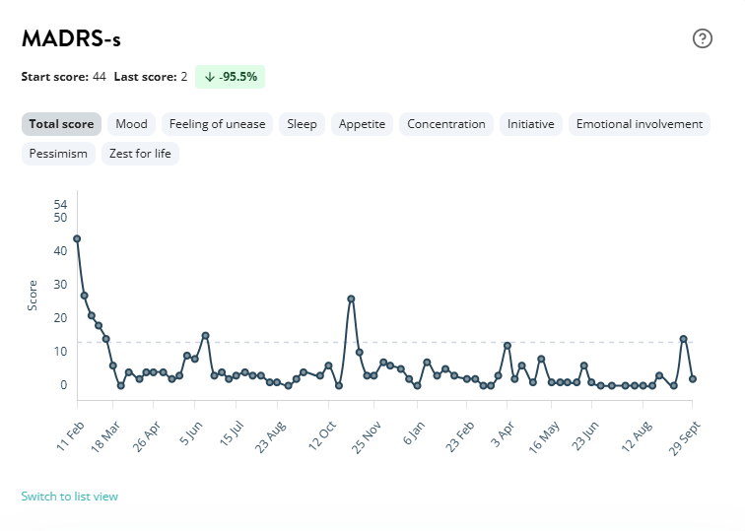
THE STORY WE OPENED WITH
Jason's story, in full
“I was still trying to end my life” → “I put the Flow headset on…” → “…now I don’t want to end my life.”
Jason's MADRS-s tracking, recorded in the Flow app
CLINICAL OUTCOME (MADRS-S)
10
Notes:
This is the turn - the moment you step back from data to a person. Read Jason's three beats slowly, not paraphrased. Pause on the final line - this is the emotional peak of the whole pitch and directly closes the loop you opened on slide one.

Slide 12
IMPACT — IN HIS OWN WORDS
Mark's story
LPT Crisis Patient
“
I was very grateful for this crisis centre, because they offered more of a range of treatments and the fact they offered me this Flow device, which seemed quite cutting edge...
I was very grateful for that because that did seem to be a turning point for me.
It seemed to me like a turning point for me in my life.
11
Notes:
This is Mark's story - read the quote in full, including the final added line. Pause before moving on.

Slide 13
SCALE — BEYOND THE PILOT
From an 80-patient pilot to a spreading national model
Adopted by 6 further NHS Trusts and NHS Practitioner Health
Shared beyond the immediate team
Published in the Open Journal of Psychiatry
Northamptonshire Healthcare NHS Foundation Trust (NHFT)
West London NHS Trust
Second manuscript (n=178), co-authored with King's College London, currently under review at the British Journal of Psychiatry
Norfolk and Suffolk NHS Foundation Trust (NSFT)
South London and Maudsley NHS Foundation Trust (SLaM)
RCPsych International Congress 2026 presentation
Lincolnshire Partnership NHS Trust
HIEM national conference: ‘Caring Together: Improving Safety Through Experiences’ 2026
Devon Partnership NHS Trust
NHS Practitioner Health (national service)
HIEM developing a case study and cost-benefit analysis tool for system-wide adoption
Now live in 8 NHS organisations — 16 individual services nationally, including internal LPT expansion into Community Mental Health Teams and specialist eating disorder programmes.
12
Notes:
This is the scale/replication story: 6 further NHS Trusts and NHS Practitioner Health, LPT's own internal expansion, and formal dissemination routes - including the second manuscript with King's College London now under review at the British Journal of Psychiatry.

Slide 14
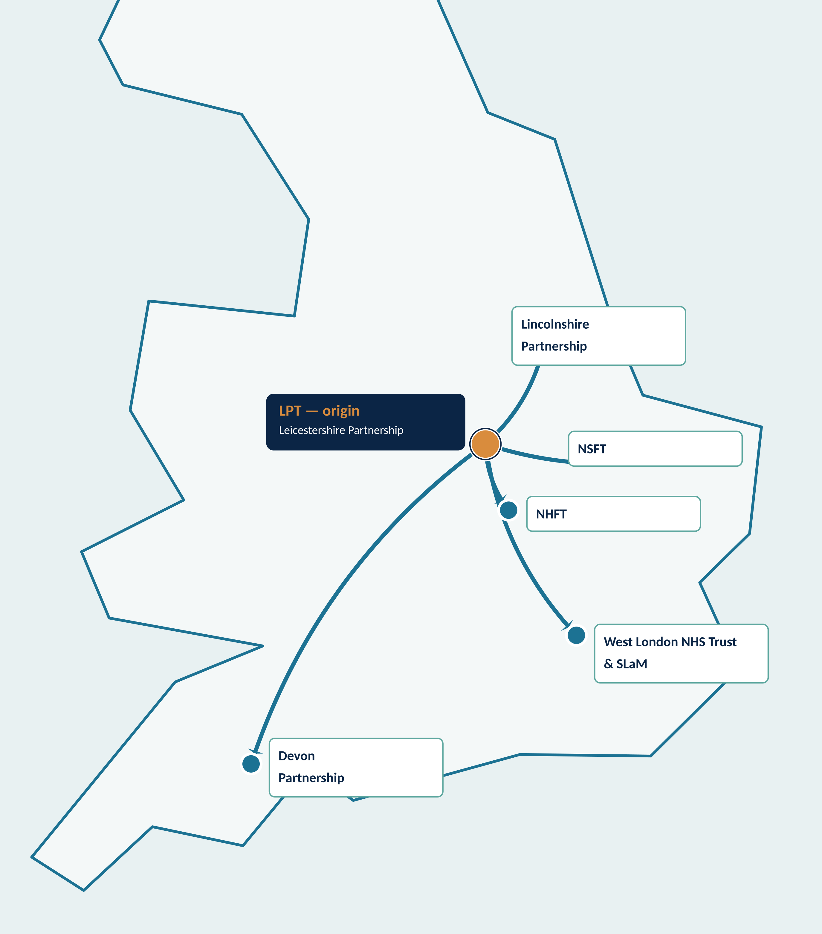
SCALE — HOW IT SPREAD
One origin site, spreading outward across England
Every adopting trust traces back to LPT's original CRT pathway.
Leicestershire Partnership NHS Trust (LPT)
Origin site — first UK NHS Crisis Team to deliver home-based tDCS.
Northamptonshire Healthcare NHS Foundation Trust (NHFT)
Adopted following direct peer-to-peer engagement with LPT's CRT.
Lincolnshire Partnership NHS Trust
Adopted after early discussions matured into a live service.
Norfolk and Suffolk NHS Foundation Trust (NSFT)
Adopted the pathway into its own crisis services.
West London NHS Trust & South London and Maudsley (SLaM)
Two London trusts independently adopted the model.
Devon Partnership NHS Trust
Most recent adopter, extending reach into the South West.
NHS Practitioner Health
A national service (not tied to one site) — now offering Flow to NHS staff across England.
13
Notes:
This is the map - point out that every adopting trust traces back to LPT. If asked how spread actually happened, the answer is direct peer-to-peer engagement and word of mouth between clinical teams, not a formal rollout programme.

Slide 15
IMPACT — NOW IN COMMUNITY MENTAL HEALTH TEAMS
Beyond crisis care: who has taken part
South Leicestershire CMHT · registered with Flow since December 2025
29
22–70
~5 years
>70%
patients registered with Flow
age range of participants
average time in mental health services during current period of care
had at least one additional mental health condition
Already tried before Flow
AT BASELINE
3+ antidepressants
All
100%
Augmentation
Half
Mood stabiliser
A third
of participants who completed the baseline measure had depression rated moderate or severe
Also: most had previously received psychological therapy; a small number had tried rTMS or ECT.
Source: LPT South Leicestershire CMHT Flow project; early service data, collection ongoing.
12
Notes:
This slide shows we've taken Flow beyond the crisis team into community mental health. Stress who these patients are: all had tried at least three antidepressants, over 70% had another mental health condition, and everyone with a baseline score was moderate or severe. These are not easy cases.

Slide 16
IMPACT — CMHT EARLY RESULTS (12-WEEK DATA, N=16)
Early results: three in four showed an improvement
75%
38%
19%
12 of 16 showed a reduction in their depression scores
6 of 16 moved into a lower clinical severity category
3 of 16 stopped treatment before 12 weeks
EACH CIRCLE IS ONE PATIENT WITH 12-WEEK DATA
WHAT THIS TELLS US
• Encouraging, given complex and long-standing depression after several prior treatments
• A small, developing project — data collection is ongoing
• Not everyone improved; some stopped treatment early
• Adherence tended to fall over time; schedules sometimes needed adjusting
reduction in score
no reduction
Early experience suggests Flow may be a useful additional option for some people with moderate to severe depression already under specialist care.
13
Notes:
Be straightforward about the small numbers: 16 patients have reached 12 weeks. Three in four improved, but not everyone did, three stopped early, and adherence fell over time. That honesty is a strength. Data as of 30 September 2026; collection continues.

Slide 17
SUSTAINABILITY
Designed from the outset to move from pilot to business as usual
Funding pathway
Low-cost delivery model
Efficient by design
Reducing inequalities
Charitable funding has bridged the pilot to expansion, building the evidence base needed for a long-term commissioning case.
Devices are reused across patients — including on inpatient wards — avoiding the need for additional clinical infrastructure or estate.
Remote adherence and outcome monitoring lets clinicians spot deterioration early and act, without adding workforce burden.
Removing travel and mobility barriers, and offering an alternative for patients who can't tolerate medication or access talking therapies.
“Given the amount of money, the device and the other big costs, for me, it was really cost effective for what it did.”
— Matt Pickard, Nursing Staff, LPT CRT
14
Notes:
This is the sustainability case: how the pilot becomes business-as-usual, the low-cost model now explicitly extending to inpatient wards, and the health-inequalities angle. Matt's quote grounds the cost-effectiveness claim in a frontline voice.

Slide 18
JASON DOESN’T WANT TO END HIS LIFE NOW.
“
We have the chance to be pioneering in using this in the NHS — it’s really making me proud. I feel it can help a whole big community of patients who are struggling with depression.
— Dr Sherif Abdalla, Consultant Psychiatrist & Joint Lead, Flow tDCS Programme
A scalable, evidence-based model of crisis care — ready to spread across mental health services nationally.
Thank you – Leicestershire Partnership NHS Trust – Crisis Resolution and Home Treatment Team
Notes:
This is the bookend - say the Jason callback line first, let it land, then move into the Abdalla quote and vision line. Thank the panel and leave time for questions.

